Slide 1
Buyer Personas for Best Fitness Inc.
By MRKT600 [Your Name]

Slide 2
Introduction
A buyer persona tells you who a buyer is, what they want, what their values are, and most importantly how to address them
Buyer Personas help the owners of the business and their employees to understand their target market
This Presentation is a presentation of two buyer personas for Best Fitness Inc.
Best Fitness In. is a new company seeking to get into the boutique fitness industry through offering products of a boutique gym.
The new location is an outdoor mall in Largo, Maryland area.
The products to be offers will include boutique gym and personal exercise packages.
Notes:
A buyer persona tells you who a buyer is, what they want, what their values are, and most importantly how to address them. Buyer personas contain detailed information about the customers of a business and contain demographic information that help to describe the behaviour trends and actors that affect the behaviour of the customers of a business. As such, they are used as representations of what a customer of a business could be. This presentation presents two buyer personas for Best Fitness Inc. and is meant to help the owners of Best Fitness Inc. structure their packages and their pricing. This is because the first step in business, especially when getting into new location is understanding your potential customers and then offering products that best suit their needs. These buyer personas, theref0ore, will go a long way in helping Best Fitness Inc. to kick off in their new location and also to remain competitive oin the market for their boutique fitness and personal exercise products.

Slide 3
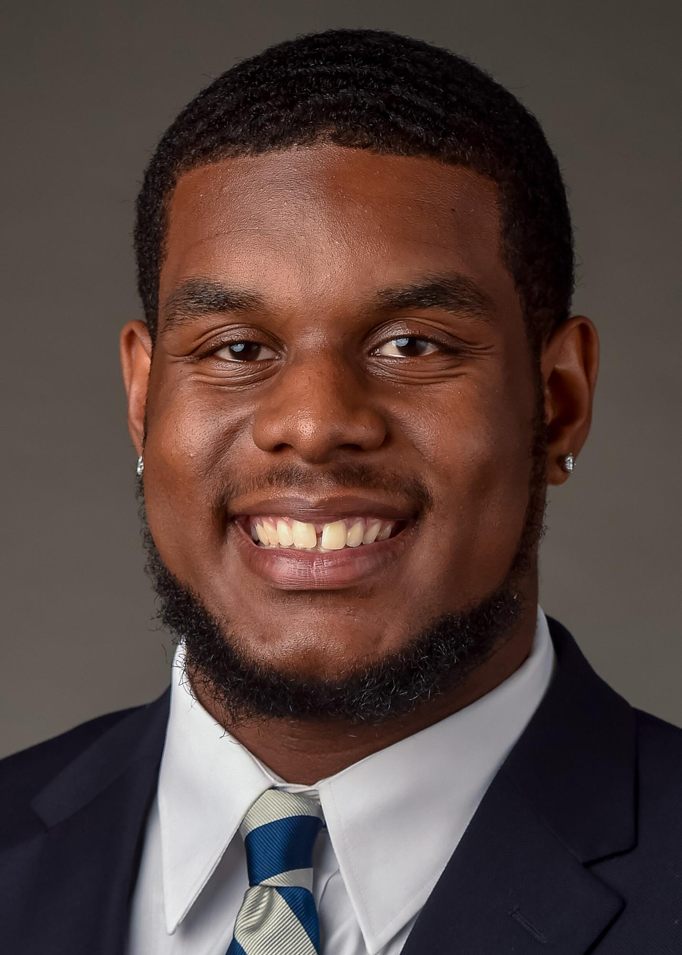
Buyer Persona 1: Background
BUYER PERSONA: GORDON WALKER
 | Age | 40 years
 | Gender | Male
 | Location | Maryland
 | Income | $76,354
Quote | Relationship | Married with one kid
“Weakness is in the mind. Everyone can achieve self-strength through willfully seeking it and practicing it”. | Job Title | Human Resource Manager
Notes:
The data of the people around Largo Maryland shows that most of them work full time jobs and spend most of the weekdays working in offices. As such, they are more likely to seek exercise opportunities such as attending gym sessions. However, since they are professions that work full time, they might want personalized exercise packages and that is why boutique gym that will be offered by Best Fitness Inc. fits them. Gordon is a resident of Maryland and a HR manager who works five days a week but loves exercising every morning and evening. Given that his income allows him to set aside extra funds, he is a representation of the cutomers likely to come for the services that will be offered by Best Fit Inc.

Slide 4
Buyer Persona 1: Biography Motivation
BIO | Gordon is a Human Resource manager at affirm in Maryland and he works five days a week. However, through out his working life he has showed enthusiasm for sports and exercise to keep fit. This emanates from the fact that he works seated most of the time. He is keen on cutting down his weight because he feels that it is beyond his desires. He does not drink alcohol but loves eating crisp. He says he would defy his doctors instructions just to eat potato crips. Every weekend, he spends some time with friends eating roasted meet
Motivation | Fear 32% Power: 90% Strong: 70%
Notes:
Gordon exhibits a desire to control his weight and loves exercising. He is a representation of the a good percentage of people in Largo who are seeking to manage their weight given that they spend most hours seated in their offices during their work. The fact that he is a great lover of roasted meet together with his friends indicates that people within his location live more or the same a life style like his and are more likely to seek gym services. This presents a perfect opportunity for Best Fitness Inc.

Slide 5
Buyer Persona 1: Pain Points (Frustrations) and Goals
Pain Points/Frustrations | Goals
Difficulty in choosing the right exercising program Difficulty in finding the best wearables to help in personal body exercising Unfamiliar with proper dieting for various age groups. Demanding work duties that allow little physical engagement | To cut down on meat consumption To cut down on consumption of potato crips To find appropriate diet for maintaining a healthy body size Controlling his body weight Having a fruitful life that creates positive impact in other people’s lives Having a self-owned gym at home for keeping his body fit.
Notes:
Like many people who work 5 days an hour, especially in offices, Gordon has seen challges in keeping a health lifestyle. He has seen his body weight increasing despite his efforts to exercise in the morning and evening and as such, he has to find an appropriate specialized gym facility that can help him manage his body weight through offering gym services and dietary advice. He struggles to refrain from eating meat. Because it is a habit to have the delicacy every weekend with friends. He also struggles to find a good diet appropriate for his age. His target is however to manage his body weight and cut down on the consumption of meat and potato crips that he loves so much. Meat and potatoes are known to be rich in protein and starch respectively and have a significant effect on body weight when consumed most often (Chapman, Alexander, Keyserling & Ammerman, 2018). Gordon is keen on keeping fit so he can impact people’ lives positively through out his lifetime. This will be a great opportunity for Best Fit Inc. because he is likely to find specialized services of the boutique gym very interesting and perfectly tailored for him.The lifestyle of people in his locality is more the same like his and this isand indication that Best Fitness Inc. will likely get enough customers within the are.

Slide 6



Buyer Persona 1: Brands and Workout Habits
Brands
Workout Habits | Morning running for 5 kilometers Evening walking for 2 kilometers Punching bag for 10 minutes every morning before taking a shower Dog walking every Saturday morning 5 kilometers.
Notes:
A look at brand preferences of people exercising within Largo are in Maryland reveals that many of them are lovers of Nike walking and running sports shoes. This is the case for Gordon because he likes running 5 kilometers every morning as part of his work out habits to help him manage his body weight and keep his body fit. In workout and excercing, appropriate wearables such as shoes, gloves and protective gears are important and the brands that dominate the sporting are Adidas and Nike. No wonder people of Largo, just as seen in preferences of Gordon have a liking for these two brands. Their income also reveals capability to afford these expensive nrands.

Slide 7
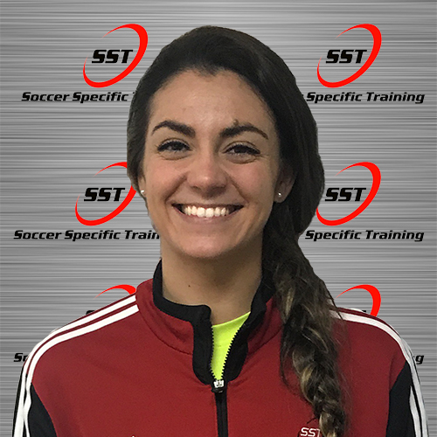
Buyer Persona 2: Background
BUYER PERSONA: SAM MARCHETTI
 | Age | 35 years
 | Gender | Female
 | Location | Upper Marlboro (Maryland)
 | Job Title | Soccer Trainer
Quote: “What a man can do, a woman is tice capable of ding it”. | Income (Annual) | $90,000
 | Relationship | Married with 2 kids
Notes:
Sam Machettti is a sports enthusiast currently running his soccer academy and a soccer trainer of kids and teenagers (Soccer Specific Training, 2019). She engages in training young girls soccer and also offers sports mentorship to teenage soccer enthusiasts. She graduated wit a psychology degree at the University but decided to engage in soccer full time. Being a lover of sports, workouts are a must to help her keep fit and she is likely to look for specialized gym classes for her regular exercising to keep fit of her rigorous soccer training job. As such, she and other trainers like her in her location are likely to seek the services of a company like Best Fitness Inc.

Slide 8
Buyer Persona 2: Biography and Motivation
BIO | MOTIVATION
Sam Marchetti is a sports enthusiast currently running his soccer academy and a soccer trainer of kids and teenagers. She engages in training young girls soccer and also offers sports mentorship to teenage soccer enthusiasts. She graduated wit a psychology degree at the University but decided to engage in soccer full time. Marchetti is married with a kid and loves to keep her diet in check as well as her body weight in check, she does this by having visits to her personal doctor twice every month to ensure that she is not loosing or gaining too much weight. She seeks to be come one of the most renowned female soccer coaches in the United Sates of America. | Existence of enthusiastic young girls wanting to be professional soccer players. The greener pastures in the sporting world Existence of various established women soccer teams and clubs that can absorb young players The existence of soccer programs within schools and university curricular of the U.S education system.
Notes:
Sa is motivated by the various positive factors existing in relation to soccer. The US is one of the countries in the world whose education system gives an opportunity to children to nature their talents. This can be seen in the way they allow sporting programs in learning institutions (Huan, Geng & Fan, 2017). In fact, the US women’s soccer team is the raining word champion. This gives a lot of motivation to a soccer trainer like Marchetti whose passion is in the same soccer field.

Slide 9
Buyer Persona 2: Pain Points/Frustrations and Goals
Pain Points/Frustrations | Goals
Difficulties in Balancing Parenting and Training Soccer Experiences hardships in marching other male coaches. Difficulty in balancing the marriage life and the demanding work of a soccer trainer. Unable to settle on one soccer brand for the sports wearables such as watches, playing kilts and shoes. Limited resources to accommodate a huge number of young soccer enthusiast. | To attain national status of a a soccer trainer To help as many young girls as possible to join professional soccer clubs. To mange her weight and her diet. To keep fit always. To be a good mother to her children and eliminate absenteeism at home. To have her one soccer academy that can have international soccer students.
Notes:
Sam seeks to reach the international levels of coaching soccer to girls and women but the fact that she is a mother plays to be an obstacle in her quest (Soccer Specific Training, 2019). She loves her family and strives to eliminate absenteeism, However, her work is demanding and may require her to be out of her home training girls out there. This limits the time she spends with her kids. However, she is keep on keeping fit and managing her body weight. She would like to maintain a light body to be able to continue playing and coaching soccer. Women in the US are faced with challnges of balancing their work and their parental roles (Esri.com, 2020)

Slide 10

Buyer Persona 2: Workout Habits
Workout Habits | Brands
Sam works out twice a day. Even though she is a soccer trainer, she exercises her hand muscles by engaging in skipping ropes and punch bags She runs 3 kilometers every evening and 3 kilometers in the morning She goes to public gym but spends only l20 minutes there.

Slide 11
References
Chapman, L. E., Alexander, R., Keyserling, T. C., & Ammerman, A. S. (2018). Diet and Weight Management. In Chronic Illness Care (pp. 71-82). Springer, Cham.
Esri.com. (2020) Soccer Moms. Retrieved 27th February 2020 from http://downloads.esri.com/esri_content_doc/dbl/us/tapestry/4A_SoccerMoms_TapestryFlier_G79488_2-18.pdf
Esri.com. (2020). Top Tier. Retrieved 27th February 2020 from http://downloads.esri.com/esri_content_doc/dbl/us/tapestry/1A_Top_Tier_TapestryFlier_G79488_2-18.pdf
Huan, C., Geng, Y., & Fan, W. (2017). Research on Construction of High-quality Sports Curriculum and Forming the Culture of Soccer in Campus.
Soccer Specific Training. (2019). SST Trainer Sam Marchetti. Retried 27th February 2020 from https://www.soccerspecifictraining.com/coaches-and-staff/
Rosman, K. (2019, June 17). The boutique fitness boom. Retrieved from https://search-proquestcom.ezproxy.umuc.edu/docview/2241534511/B35ABD891821444APQ/1?a ccountid=14580

